Slide 1
COMPUTER ARCHITECTURE
1

Slide 2
GENERAL INFORMATION
Course : Computer Architecture (CSE 2213)
Instructor : Ashna Nawar Ahmed
Lecturer,
Department of CSE, AUST
Email : ashna.cse@aust.edu
Contact# : 01710812206
Room# : 7A01/J
Acknowledgements: These slides contain some materials developed and copyrighted by Swapna S. Gokhale

Slide 3
READING
Reading the text is imperative.
Computer architecture especially processor design, changes rapidly.
You really have to keep up with the changes in the industry.
This is especially important for job interviews later.

Slide 4
WHAT WILL WE LEARN?
Computer Architecture
  The science and art of designing the hardware/software interface and designing, selecting, and interconnecting hardware components to create a computing system that meets functionality requirements, performance, energy consumption, cost, and other specific goals.

Slide 5
TASKS OF A COMPUTER ARCHITECT
Determine which attributes are important for a new computer.
Design a computer to maximize performance and energy efficiency while staying within cost, power and availability constraints. This task has many aspects:
a) instruction set design
b) functional organization
c) logic design
d) implementation; which encompass
i. integrated circuit design
ii. packaging
iii. power and cooling
Optimizing the design.

Slide 6
WHAT IS “COMPUTER ARCHITECTURE” ?
Computer Architecture =
Instruction Set Architecture + Computer Organization
Instruction Set Architecture (ISA)
  WHAT the computer does (logical view)
Computer Organization
  HOW the ISA is implemented (physical view)
We will study both in this course

Slide 7
INSTRUCTION SET ARCHITECTURE
Instruction set architecture is the attributes of a computing system as seen by the assembly language programmer or compiler.
  Instruction Set (what operations can be performed?)
  Instruction Format (how are instructions specified?)
  Data storage (where is data located?)
  Addressing Modes (how is data accessed?)
  Exceptional Conditions (what happens if something goes wrong?)

Slide 8
COMPUTER ORGANIZATION
Computer organization is the view of the computer that is seen by the logic designer. This includes
  Capabilities & performance characteristics of functional units (e.g., registers, ALU, shifters, etc.).
  Ways in which these components are interconnected
  How information flows between components
  Logic and means by which such information flow is controlled
  Coordination of functional units

Slide 9
WHAT IS A COMPUTER?
a computer is a electronic calculating machine that:
  Accepts digitized input information,
  Processes the information according to a list of internally stored instructions and
  Produces the resulting output information.
The list of instructions is called a computer program, and the internal storage is called computer memory.
Functions performed by a computer are:
  Accepting information to be processed as input.
  Storing a list of instructions to process the information.
  Processing the information according to the list of instructions.
  Providing the results of the processing as output.

Slide 10
BASIC FUNCTIONAL UNITS OF A COMPUTER
Input unit accepts
information:
Human operators,
Electromechanical devices (keyboard)
Other computers
Arithmetic and logic unit(ALU):
Performs the desired
operations on the input
information as determined
by instructions in the memory
Memory
Arithmetic
& Logic
Input
Instr1
Instr2
Instr3
Data1
Data2
Output
Control
I/O
Processor
Memory unit
Stores
information:
Instructions,
Data
Control unit coordinates
various actions
Input,
Output
Processing
Output unit sends
results of processing:
To a monitor display,
To a printer
Notes:
5 - 2

Slide 11
INFORMATION IN A COMPUTER -- INSTRUCTIONS
Instructions are explicit commands that:
  Transfer information within a computer (e.g., from memory to ALU)
  Transfer of information between the computer and I/O devices (e.g., from keyboard to computer, or computer to printer)
  Perform arithmetic and logic operations (e.g., Add two numbers, Perform a logical AND).
A sequence of instructions to perform a task is called a program, which is stored in the memory.
Processor fetches instructions that make up a program from the memory and performs the operations stated in those instructions.
What do the instructions operate upon?

Slide 12
INFORMATION IN A COMPUTER -- DATA
Data are the “operands” upon which instructions operate.
Data could be:
  Numbers,
  Encoded characters.
Data, in a broad sense means any digital information.
Computers use data that is encoded as a string of binary digits called bits.

Slide 13
INPUT UNIT
Binary information must be presented to a computer in a specific format. This
task is performed by the input unit:
- Interfaces with input devices.
- Accepts binary information from the input devices.
- Presents this binary information in a format expected by the computer.
- Transfers this information to the memory or processor.
Real world
Computer
Memory
Input Unit
Keyboard
Audio input
……
Processor

Slide 14
MEMORY UNIT
Memory unit stores instructions and data.
  Recall, data is represented as a series of bits.
  The memory contains a large number of semiconductor storage cells each capable of storing one bit of information.

Slide 15
MEMORY UNIT
Processor reads instructions and reads/writes data from/to the memory during the execution of a program.
  In theory, instructions and data could be fetched one bit at a time.
  In practice, a group of bits is fetched at a time.
  Group of bits stored or retrieved at a time is termed as “word”
  Number of bits in a word is termed as the “word length” of a computer. Typical word lengths range from 16 to 64 bits.
In order to read/write to and from memory, a processor should know where to look: “Address” is associated with each word location, addresses are numbers that identify successive locations. (Memory address)

Slide 16
MEMORY UNIT (CONTD..)
Processor reads/writes to/from memory based on the memory address:
  Access any word location in a short and fixed amount of time based on the address.
  Random Access Memory (RAM) provides fixed access time independent of the location of the word.
  Access time is known as “Memory Access Time”.
Memory and processor have to “communicate” with each other in order to read/write information.
  In order to reduce “communication time”, a small amount of RAM (known as Cache) is tightly coupled with the processor.
Modern computers have three to four levels of RAM units with different speeds and sizes:
  Fastest, smallest known as Cache
  Slowest, largest known as Main memory.
Notes:
Since the instructions and data need to be fetched from the memory in order to perform a task, the time it takes to access and fetch this information will be one factor influencing how fast a given task will complete. In order to increase the speed of performing a task, one way is to reduce the amount of time it takes to fetch the data and the instructions. This time is called as “access time”.
Suppose if we want to fetch the data at memory location with the address 10. In case of sequential access, we have to access locations 1-9, and then access location 10. Clearly, in case of sequential access the access times increase as memory locations with higher access times are accessed. We need some kind of memory which provides fixed and short access time irrespective of the memory location being accessed. That is, it provides random access.
Why is the access time faster for the Cache than it is for primary storage? I haven’t yet discussed how the various units communicate with each other. In a few minutes I will discuss that, and it will become clear.

Slide 17
MEMORY UNIT (CONTD..)
There are 2 classes of storage called primary and secondary.
Primary storage of the computer consists of RAM units.
  Fastest, smallest unit is Cache.
  Slowest, largest unit is Main Memory.
Primary storage is insufficient to store large amounts of data and programs.
  Primary storage can be added, but it is expensive.
Store large amounts of data on secondary storage devices:
  Magnetic disks and tapes,
  Optical disks (CD-ROMS).
  Access to the data stored in secondary storage in slower, but take advantage of the fact that some information may be accessed infrequently.
Cost of a memory unit depends on its access time, lesser access time implies higher cost.

Slide 18
ARITHMETIC AND LOGIC UNIT (ALU)
Most computer operations are executed in the Arithmetic and Logic Unit (ALU).
  Arithmetic operations such as addition, subtraction.
  Logic operations such as comparison of numbers.
In order to execute an instruction, operands need to be brought into the ALU from the memory.
  Operands are stored in general purpose registers available in the ALU.
  Access times of general purpose registers are faster than the cache.
Results of the operations are stored back in the memory or retained in the processor for immediate use.
Notes:
Z=x+y
W=z+2

Slide 19
OUTPUT UNIT
Computers represent information in a specific binary form. Output units:
- Interface with output devices.
- Accept processed results provided by the computer in specific binary form.
- Convert the information in binary form to a form understood by an
output device and send processed results to the outside world.
Computer
Real world
Memory
Printer
Graphics display
Speakers
……
Output Unit
Processor

Slide 20
CONTROL UNIT
Operation of a computer can be summarized as:
  Accepts information from the input units (Input unit).
  Stores the information (Memory).
  Processes the information (ALU).
  Provides processed results through the output units (Output unit).
Operations of Input unit, Memory, ALU and Output unit are coordinated by Control unit.
Instructions control “what” operations take place (e.g. data transfer, processing).
Control unit generates timing signals which determines “when” a particular operation takes place.

Slide 21
HOW ARE THE FUNCTIONAL UNITS CONNECTED?
For a computer to achieve its operation, the functional units need to
communicate with each other.
In order to communicate, they need to be connected.
Input
Output
Memory
Processor
Bus
Functional units may be connected by a group of parallel wires.
The group of parallel wires is called a bus.
Each wire in a bus can transfer one bit of information.
The number of parallel wires in a bus is equal to the word length of
a computer
Notes:
What is a word? What is a word length? During the discussion of which functional unit did we come across this concept?

Slide 22
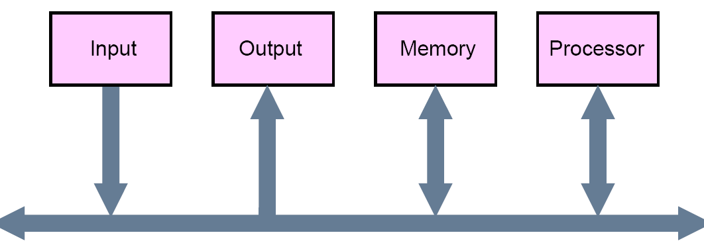
BUS STRUCTURES
A group of lines that serves a connecting path for several devices is called a bus
  In addition to the lines that carry the data, the bus must have lines for address and control purposes
  The simplest way to interconnect functional units is to use a single bus, as shown below (Single bus structure)

Slide 23
DRAWBACKS & ADVANTAGES OF THE SINGLE BUS STRUCTURE
The devices connected to a bus vary widely in their speed of operation
  Some devices are relatively slow, such as printer and keyboard
  Some devices are considerably fast, such as optical disks
  Memory and processor units operate are the fastest parts of a computer
Efficient transfer mechanism thus is needed to cope with this problem
  A common approach is to include buffer registers with the devices to hold the information during transfers
  Advantages of the Single Bus Structure:
  Low cost
  Flexibility for attaching peripheral devices

Slide 24
ORGANIZATION OF CACHE AND MAIN MEMORY
Main
Cache
Processor
memory
memory
Bus
Why is the access time of the cache memory lesser than the
access time of the main memory?

Slide 25
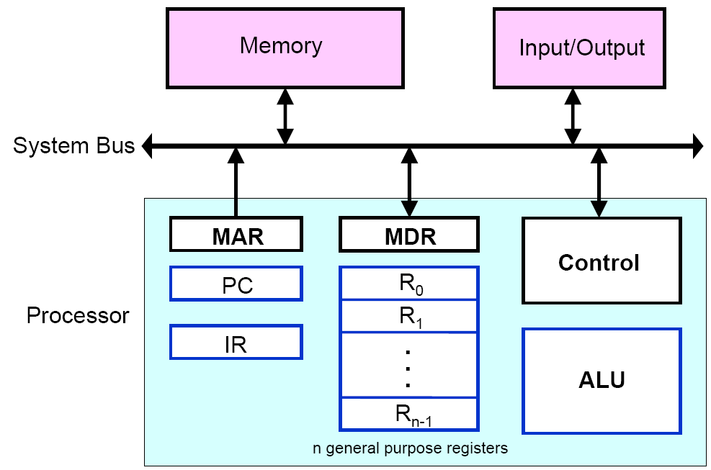
COMPUTER COMPONENTS: TOP-LEVEL VIEW
Notes:
memory address register (MAR)
memory data register (MDR)

Slide 26
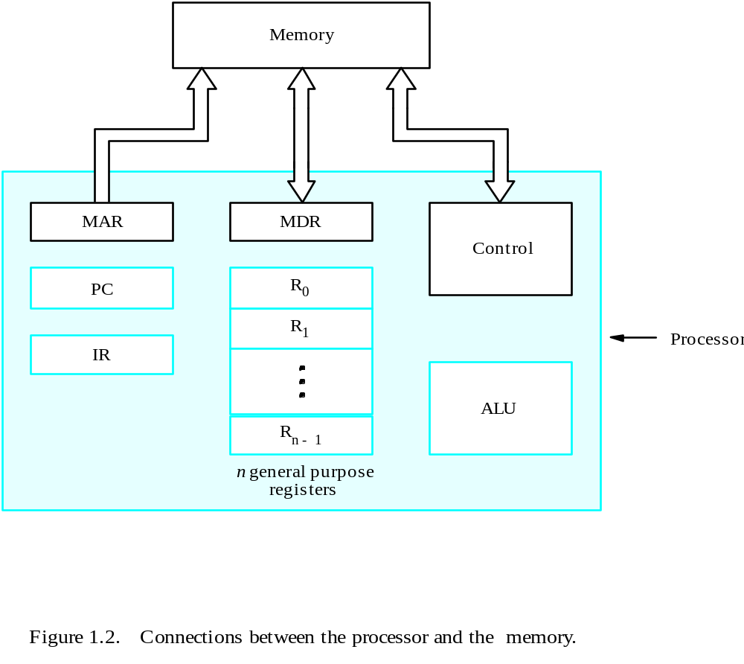
BASIC OPERATIONAL CONCEPTS

Slide 27
REVIEW
Activity in a computer is governed by instructions.
To perform a task, an appropriate program consisting of a list of instructions is stored in the memory.
A Program = A sequence of instructions : Assembly language or Machine language instructions
Individual instructions are brought from the memory into the processor, which executes the specified operations.
Data to be used as operands are also stored in the memory.
Notes:
1 --→load
5--→ add
2---→store

Slide 28
A TYPICAL INSTRUCTION
MOV LOCA, R0
General format:
Instruction = Operation source_operand destination_operand
Moves the operand at memory location LOCA to the operand in a register R0 in the processor.
Simply: Moves the contents of Memory Location LOCA to the processor register R0
The original contents of LOCA are preserved.
The original contents of R0 is overwritten.
Instruction that Moves data from Memory to Register is called LOAD instruction (e.g., MOV LOCA, R0)
Instruction that moves data from Register to Memory is called STORE instruction (e.g., MOV R0, LOCA)

Slide 29
ANOTHER TYPICAL INSTRUCTION
ADD LOCA, R0
General format:
Instruction = Operation Source_operand Destination_operand
Add the operand at memory location LOCA to the operand in a register R0 in the processor.
Place the sum into register R0.
The original contents of LOCA are preserved.
The original contents of R0 is overwritten.
Instruction is fetched from the memory into the processor – the operand at LOCA is fetched and added to the contents of R0 – the resulting sum is stored in register R0.

Slide 30
LOAD AND STORE INSTRUCTIONS TO TRANSFER FROM/TO MEMORY TO/FROM REGISTERS
Summary:
MOV LOCA, R1 = means => Bring the content of memory location A into Register R1
MOV R2, LOCB = means => save the value of register R2 in memory location B
ADD R1, R0 == means => R0 ← [R0] + [R1] (Add the contents of both the registers R0 and R1 and store into register R0
  For ADD, whose contents will be overwritten? (R0)
Load and Store Instructions
LOAD LOCA, R1 equivalent to MOV LOCA, R1
STORE R2, LOCB equivalent to MOV R2, LOCB

Slide 31
EXAMPLES OF A FEW REGISTERS:
Instruction register (IR): Holds the instruction that is currently executing by the CPU
Program counter register (PC): Points to (i.e., holds the address of) the next instruction that will be fetched from the memory to be executed by the CPU
General-purpose registers (R₀ – R_{n-1}): generally holds the operands for executing the instructions of current program
Memory address register (MAR): Holds the memory address to be read. A read signal from the CPU to the memory module reads the word address held by the MAR register
Memory data register (MDR): Contains the data to be written into or read out of the addressed location i.e Facilitates the transfer of operands/data to/from Memory from/to the CPU.

Slide 32
EXECUTING A PROGRAM ... BASIC OPERATING STEPS
Programs reside in the main memory (RAM) through input devices
PC register’s value is set to the first instruction
Repeat the following Steps Until the “END” instruction is executed
Instruction fetch: -The contents of PC are transferred to MAR
-A Read signal is sent by CU to the memory
-The Memory module reads out the location addressed by MAR register. The contents of that location is loaded into (returned by) MDR
-The contents of MDR are transferred to IR register
  Decode and execute -At this point, the instruction is ready to be decoded and executed. Instruction in the IR is examined (decoded) to determine which operation is to be performed.
  - Get operands for ALU: Fetch the operands from the memory or registers.

Slide 33
EXECUTING A PROGRAM ... BASIC OPERATING STEPS…
  -The operand may already in a General-purpose register
  -Or, may be fetched from Memory (send address to MAR – send Read signal to Memory module – Wait for MFC signal (WMFC) from Memory – Get the operand/data from MDR)
Perform operation in ALU
Store the result back
  Store in a general-purpose register
  Or, store into memory (send the write address to MAR, and send result to MDR – Write signal to Memory – WMFC)
  WMFC = Wait for Memory Function Complete Signal
Meanwhile, PC is incremented to the next instruction
Some Examples: Add R₀, R₁; Add (R₀), R₁; Add 50(R₀), R₁;

Slide 34
INTERRUPT
Normal execution of programs may be interrupted if some device requires urgent servicing
  To deal with the situation immediately, the normal execution of the current program must be interrupted
Procedure of interrupt operation
  The device raises an interrupt signal
  The processor provides the requested service by executing an appropriate interrupt-service routine
  The state of the processor is first saved before servicing the interrupt
    Normally, the contents of the PC, the general registers, and some control information are stored in memory
  When the interrupt-service routine is completed, the state of the processor is restored so that the interrupted program may continue

Slide 35
CLASSES OF INTERRUPTS
Program
  Generated by some condition that occurs as a result of an instruction execution such as arithmetic overflow, division by zero, attempt to execute an illegal machine instruction, or reference outside a user’s allowed memory space
Timer
  Generated by a timer within the processor. This allows the operating system to perform certain functions on a regular basis
I/O
  Generated by an I/O controller, to signal normal completion of an operation or to signal a variety of error conditions
Hardware failure
  Generated by a failure such as power failure

Slide 36
SOFTWARE
In order for a user to enter and run an application program, the computer must already contain some system software in its memory
System software is a collection of programs that are executed as needed to perform functions such as
  Receiving and interpreting user commands
  Running standard application programs such as word processors, etc, or games
  Managing the storage and retrieval of files in secondary storage devices
  Controlling I/O units to receive input information and produce output results

Slide 37
SOFTWARE
Translating programs from source form prepared by the user into object form consisting of machine instructions
Linking and running user-written application programs with existing standard library routines, such as numerical computation packages
System software is thus responsible for the coordination of all activities in a computing system

Slide 38
OPERATING SYSTEM
Operating system (OS)
  This is a large program, or actually a collection of routines, that is used to control the sharing of and interaction among various computer units as they perform application programs
The OS routines perform the tasks required to assign computer resource to individual application programs
  These tasks include assigning memory and magnetic disk space to program and data files, moving data between memory and disk units, and handling I/O operations

Slide 39
PERFORMANCE
The most important measure of a computer is how quickly it can execute programs i.e., Runtime of programs. The speed with which a computer executes programs is affected by the design of its hardware and its machine language instructions. Because programs are usually written in a high-level language, performance is also affected by the compiler that translates programs into machine languages.
For best performance, the following factors must be considered
  Compiler
  Instruction set
  Hardware design

Slide 40
PERFORMANCE
Three factors affect performance:
Hardware design (e.g., CPU clock rate)
  1GHz CPU => 1 Billion Hz => 10⁹ clock cycles/sec (Hz=cycles/sec)
    1 basic operation (e.g., integer addition) possible in 1 cycle => 1 billion basic operations (10⁹ integer additions!) possible in 1 sec!!! WOW!!!
  1Mhz => 1 Million Hz => 10⁶ clock cycles/sec
Instruction set architecture (ISA) (e.g., CISC or RISC ISA?)
  CISC => instructions complex, more capable, but runs slower
  RISC => instructions Simple, runs faster, but less capable
Compiler (how efficient your compiler to optimize your code for pipelining...etc?)

Slide 41
PERFORMANCE
Processor circuits are controlled by a timing signal called a clock
  The clock defines regular time intervals, called clock cycles
To execute a machine instruction, the processor divides the action to be performed into a sequence of basic steps, such that each step can be completed in one clock cycle
Let the length P of one clock cycle, its inverse is the clock rate, R=1/P

Slide 42
PROCESSOR CLOCK
Clock, clock cycle, and clock rate
  Clock Rate = 1 GHz = 10⁹ Hz = 10⁹ cycles/second or 10⁹ clock pulses per second !!! WOW!!! It also means it has a Clock Cycle of 1/10⁹ =10⁻⁹ sec = 1 ns (nano-second).
  4GHz CPU => 4x10⁹ cy/sec => 1 clock cycle = 0.25 ns
  500 MHz => 500x10⁶ cycles/sec => 2 ns clock pulses
  1 MHz = 10⁶ cycles/sec; 1KHz=10³ cycles/sec
  1GHz=1000MHz, 1MHz=1000KHz, 1KHz=1000Hz
  Hz (Hertz) – cycles per second (clock cycles / second)

Slide 43
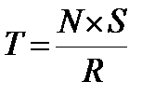
BASIC PERFORMANCE EQUATION
T – processor time required to execute a program that may have been prepared in high-level language
N – Dynamic Instruction Count. It is the number of actual machine language instructions needed to complete the execution (note: A single 1-line loop may execute more than a billion times !!! )
S – average number of basic steps (or, clock cycles) needed to execute one machine instruction. Each basic step completes in one clock cycle. Unit: cycles/instruction
R – clock rate: cycles/sec
Note: these are not independent to each other
How to improve T?
- reduce N x S, Increase R

Slide 44
BASIC PERFORMANCE EQUATION
T–program execution time. Unit: second
N – Unit: instructions
S – Unit: cycles/instructions
R–clock rate: cycles/second
Example: A program with dynamic instruction count (N) of 1000 instructions, each instruction taking 5 cycles on average (S=5 cycles/instruction) and running at a speed of 1KHZ (R = 10³ 0r 1000 cycles/second), what will be the program execution time T?
Ans: T= 1000 instructions x 5cycles/ instruction
1000 cycles/sec
= 5 sec

Slide 45

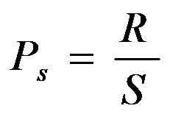

OVERVIEW
The execution time T of a program that has a dynamic instruction count N is given by:
Here S is the average number of clock cycles it takes to fetch and execute one instruction, and R is the clock rate. (The dynamic instruction count N is computed considering loops, repeated function calls, recursion, etc!)
Instruction throughput is defined as the number of instructions executed per second.

Slide 46
PERFORMANCE IMPROVEMENT
Pipelining and superscalar operation
  Pipelining: by overlapping the execution of successive instructions
  Superscalar: different instructions are concurrently executed with multiple instruction pipelines. This means that multiple functional units are needed
Clock rate improvement
Improving the integrated-circuit technology makes logic circuits faster, which reduces the time needed to complete a basic step

Slide 47
PERFORMANCE IMPROVEMENT
Reducing amount of processing done in one basic step also makes it possible to reduce the clock period, P.
However, if the actions that have to be performed by an instruction remain the same, the number of basic steps needed may increase
Reduce the number of basic steps to execute
  Reduced instruction set computers (RISC) and complex instruction set computers (CISC)

Slide 48
IMPROVING PERFORMANCE: EFFECT OF INSTRUCTION SET ARCHITECTURES (ISA), E.G., CISC AND RISC ISA
Reduced Instruction Set Computers (RISC): simpler instructions => N ↑, S ↓, Better than CISC, because Pipelining is more effective for RISC!!
Complex Instruction Set Computers (CISC):
Complex instructions => N ↓ , S ↑, Not Good, As not suitable for Pipelining!! Instructions complex, more capable => the program gets smaller in size (reduced N), but complex instructions increase S and hampers/stalls pipeline. Example of CISC: Intel processors
So, A key consideration is the use of Pipelining
S is close to 1, means the number of cycles per instruction is nearly ideal / small (close to 1) (e.g. RISC processors)
RISC is Better, because easier to implement efficient pipelining with simpler instruction sets. (example of RISC architecture: ARM processors
Notes:
N – Dynamic Instruction Count
S – average number of basic steps

Slide 49
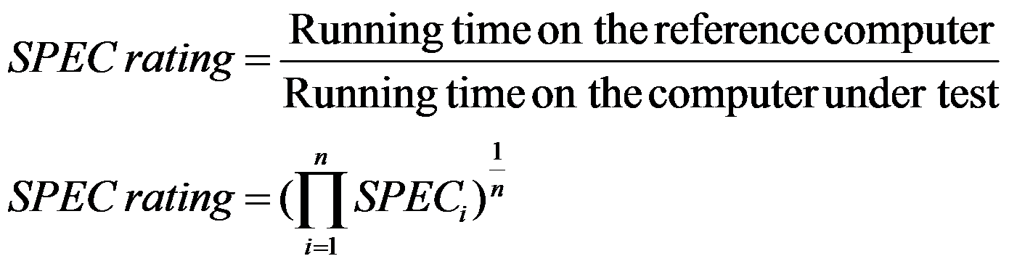
PERFORMANCE MEASUREMENT
T is difficult to compute. Also, T has inappropriate unit (second) for commercial use.
Measure computer performance using benchmark programs (a set of sample programs, e.g., word processing programs, games, media (audio/video) playback , I/O intensive programs, etc ...).
System Performance Evaluation Corporation (SPEC) selects and publishes representative application programs for different application domains, together with test results for many commercially available computers.
Reference computer: A previous, renowned computer system, picked by SPEC

Slide 50
MULTIPROCESSORS AND MULTI-COMPUTERS
Multiprocessor computer
Good for Executing several different application tasks in parallel
Good for Executing subtasks of a single large task in parallel
All processors have access to all of the memory – shared-memory multiprocessor. Example: Some commercial server computers using two/four processors. www.cpubenchmark.net/multi_cpu.html
Cost– processors, memory units, complex interconnection networks
Multi-computers
Each computer only have access to its own memory
Example: a Network of computers, such as a LAN (Local Area Network), WAN (wide area network) or MAN (metropolitan area network) etc.
Exchange message via a communication network – message-passing multi-computers

